Slide 1
Day 2 – Teradata Optimization
SQL Assistant
Data Labs
Tables / Temporal
Statistics
Partitioning
Compression (Multi Value versus Block)
Indexes
SQL Tips and Tricks (DBC/DBQL)
Quiz

Slide 2
Resources
RTM – Read The Manual!
Teradata has great documentation
\\pusehf0g\grouperp\Teradata\Documentation
Teradata has lots of documentation (http://www.info.teradata.com/)
Ask Google!
Teradata Forums (http://forums.teradata.com/forum)
Teradata Developer Exchange (http://developer.teradata.com)

Slide 3
Example

Slide 4
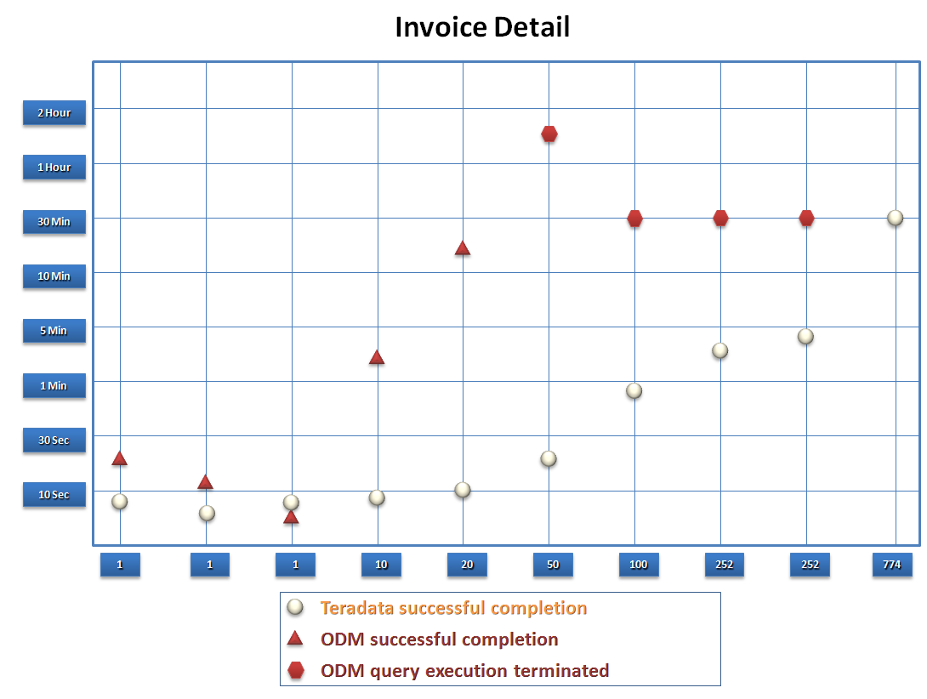
15,768

Slide 5
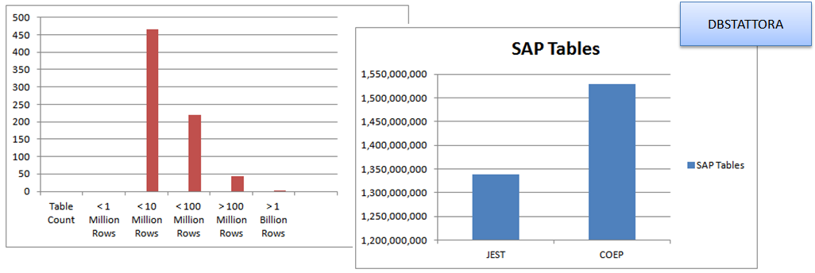
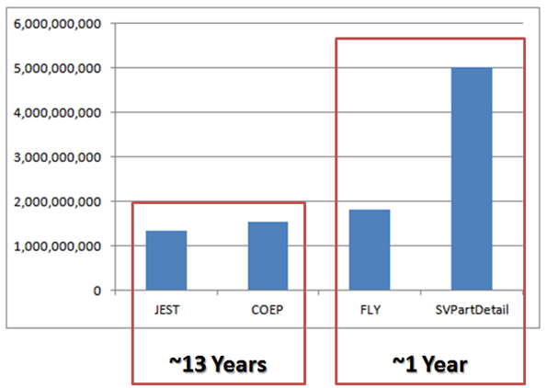

Slide 6
ADEM Example

Slide 7
SQL Assistant
Navigation
Adding databases
Executing queries
Additional functions
History Tab
Options
Import / Export functionality
Help -> Query Builder
Teradata SQL Assistant for Microsoft Windows User Guide.pdf

Slide 8
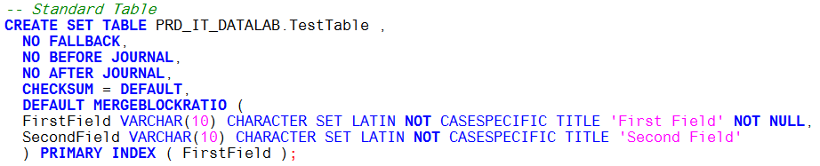
Tables
Kinds of Tables
SET (does not allow duplicate rows)
MULTISET (allows duplicate rows)
Data protection
FALLBACK (creates a duplicate record to be used if he primary becomes unavailable)
JOURNAL provides data protection through system-generated BEFORE- and AFTER-journals that contain the before and after images of data that changes
CHECKSUM (implements disk I/O integrity checking of primary table data rows, fallback table data rows, and secondary index subtable rows at various user-specified or system-wide levels.

Slide 9
Primary Index

Slide 10
Primary Index
Every table requires a “Primary Index”
If you don’t define one, the first field in table becomes the primary index
The primary index does not have to be the primary key
The primary index does not have to be unique
Primary index should be as granular as possible
Primary index should be based on the fields most frequently used to access the table
If possible, always use every field of the primary index
Pratt & Whitney Proprietary
This document contains no technical data subject to EAR or ITAR.

Slide 11
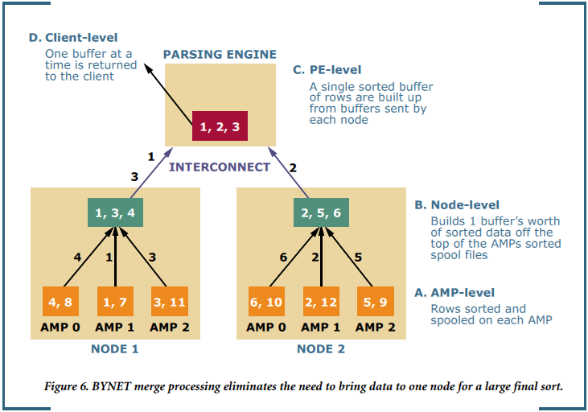
Primary Index
Primary Index is the sole determinant of which AMP owns which rows
Teradata uses HASH values to store data on AMPs
Teradata Production – 120 AMPs
Teradata Quality – 16 AMPs
Teradata Development – 4 AMPs
Poorly distributed data causes “Skew”
Teradata provides functions to calculate the hash values
HASHROW – returns the row hash value for a given value
HASHBUCKET – the grouping of a specific hash value
HASHAMP – the AMP that is associated with the hash bucket
HASHBAKAMP – fallback AMP for any HASHBUCKET number
Pratt & Whitney Proprietary
This document contains no technical data subject to EAR or ITAR.

Slide 12
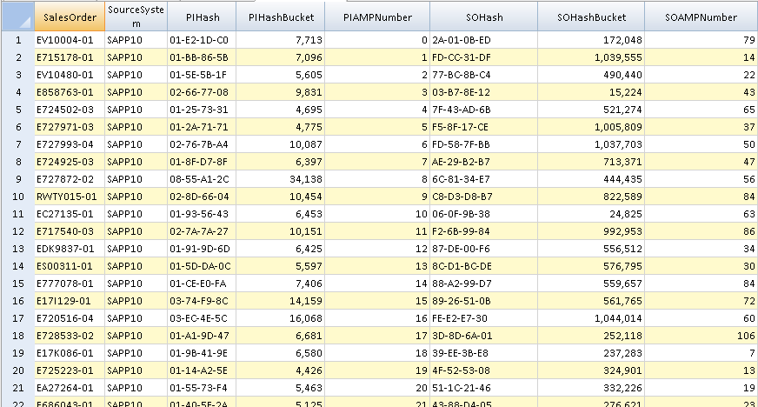
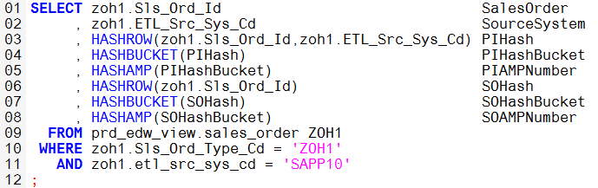
Primary Index
Primary Index on table SALES_ORDER is:
Sls_Ord_Id”
ETL_Src_Sys_Cd
If we only use Sls_Ord_Id data retrieval will not be optimized
Pratt & Whitney Proprietary
This document contains no technical data subject to EAR or ITAR.

Slide 13
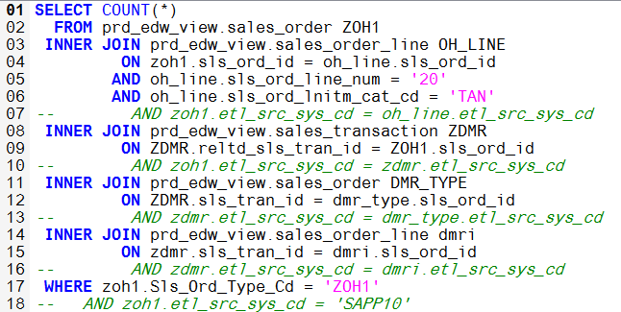
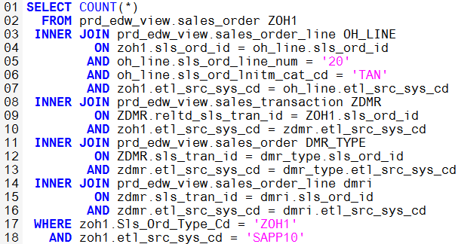
Primary Index
In the above queries, ETL_Src_Sys_Cd is part of the primary index for all tables
The value in ETL_Src_Sys_Cd is equal to ‘SAPP10’ on all records
On the surface it may seem that there is no benefit to using ETL_Src_Sys_Cd
Query on the left takes 19 seconds to run
Query on the right takes 12 seconds to run
Pratt & Whitney Proprietary
This document contains no technical data subject to EAR or ITAR.

Slide 14
Statistics
Statistical information is vital for the optimizer when it builds query plans
Stats are created the first time a stats command is executed
COLLECT STATISTICS ON <DatabaseName>.<TableName> INDEX (ColumnName1, ColumnName2, etc…)
COLLECT STATS ON m304444.zdmr1 COLUMN customerid;
COLLECT STATS ON m304444.zdmr1 COLUMN (PayerID, Payer);
To maintain statistics
COLLECT STATISTICS ON <DatabaseName>.<TableName>
Prd_it_datalab-StatsInfo (quick look at the state of your stats)

Slide 15
Partitioning
Partitions exist as part of a table’s definition
Partitions physically segregate the data of a table
Partitions should be defined on the fields most commonly used to access the data
Queries benefit from partitioning when partitions are eliminated
Partition elimination occurs when queries filter based on partition values
Pratt & Whitney Proprietary
This document contains no technical data subject to EAR or ITAR.

Slide 16
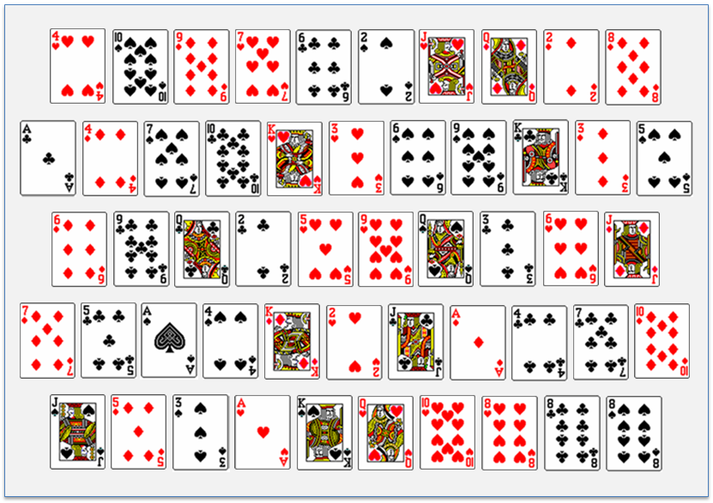
Find the “4 of clubs”
Pratt & Whitney Proprietary
This document contains no technical data subject to EAR or ITAR.

Slide 17




Find the “4 of clubs”
1
2
3
4
Pratt & Whitney Proprietary
This document contains no technical data subject to EAR or ITAR.

Slide 18
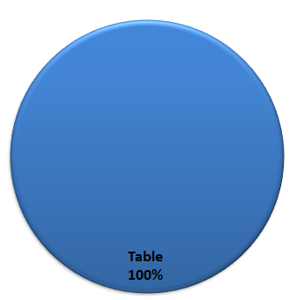
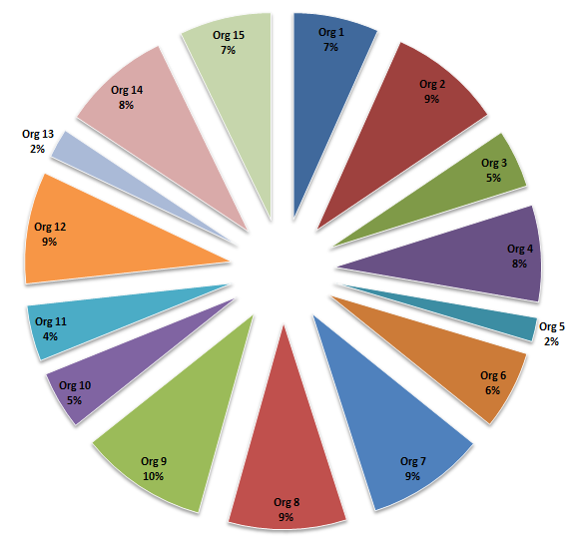
Large table with 1.5 billion rows
Every query executed against the table must filter through all 1.5 billion rows
Partitioning the table on organization physically segregates the data based on organization values
Every query executed against the partitioned table that uses Org as a filter, only reads through the matching partitions
If a query filters with Org 4, the query only needs to run through 120 million rows instead of 1.5 billion
Pratt & Whitney Proprietary
This document contains no technical data subject to EAR or ITAR.

Slide 19
Single Partition Read
Non-Partitioned
Aggregation of 31,719,295
Non-Partitioned
Aggregation of 1,589,727
Partitioned
Aggregation of 31,719,295
Partitioned
Aggregation of 1,589,727
70 sec
60 sec
50 sec
40 sec
30 sec
20 sec
10 sec
1 sec
259,166,982
500,208,801
1,072,567,776
2,145,135,552
4,290,271,104
Row Count
Pratt & Whitney Proprietary
This document contains no technical data subject to EAR or ITAR.

Slide 20
Multiple vs. Full Partition Read
Non-Partitioned
(BETWEEN) Aggregation of 105,130,597
Non-Partitioned
(IN) Aggregation of 105,130,597
Partitioned – Without SQL elimination
(BETWEEN) Aggregation of 105,130,597
Partitioned – With SQL elimination
(IN) Aggregation of 105,130,597
70 sec
60 sec
50 sec
40 sec
30 sec
20 sec
10 sec
1 sec
259,166,982
500,208,801
1,072,567,776
2,145,135,552
4,290,271,104
Row Count
Pratt & Whitney Proprietary
This document contains no technical data subject to EAR or ITAR.

Slide 21
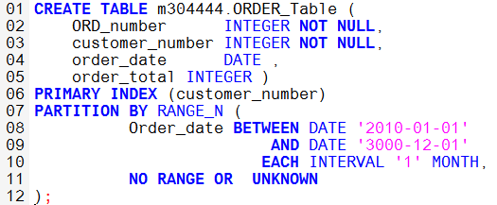
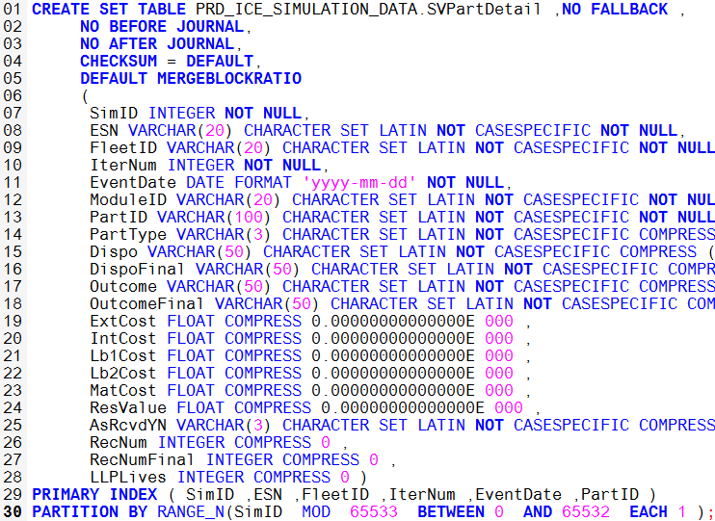
How to create a Partition
Partitions are defined as part of the table
Partitions can be defined using RANGE_N or CASE_N
The first SQL partitions the table into monthly buckets
Perfect for financial tables
NO RANGE creates a partition for any records where the values do not fall within the defined ranges
UNKNOWN creates a partition for any records where the value is NULL
The second SQL is what we refer to as “The Rice” partition
Pratt & Whitney Proprietary
This document contains no technical data subject to EAR or ITAR.

Slide 22
The “Rice” Partition
The Rice partition uses a numeric value and calculates the remainder based on dividing by the max number of partitions (65,533)
SVPartDetail record count (2,598,920,192)
Average number of records per simulation (4,099,243)
First 65,533 simulations get their own partition
Each partition is spread across all 120 AMPs based on the Primary Index
1
2
3
4
5
6
7
65,533
Pratt & Whitney Proprietary
This document contains no technical data subject to EAR or ITAR.

Slide 23
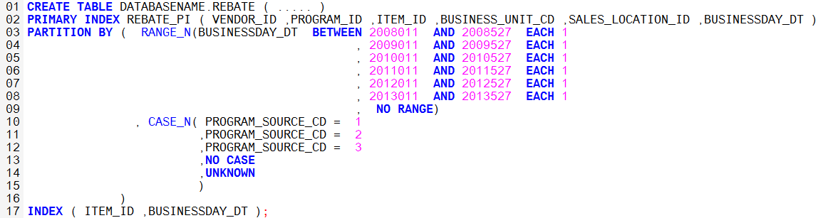
Partitions
A table can have multiple partitions
Security becomes key to defining partitions
Export (partition on jurisdiction and classification)
Organization (partitions on Sales Organization, Company Code, Plant, Partnerships)
Customers (partitions on Sold To, End User, etc.)
If a partition does not work, an alter statement can change it
Pratt & Whitney Proprietary
This document contains no technical data subject to EAR or ITAR.

Slide 24
Compression
Multi Value Compression
Block Compression

Slide 25
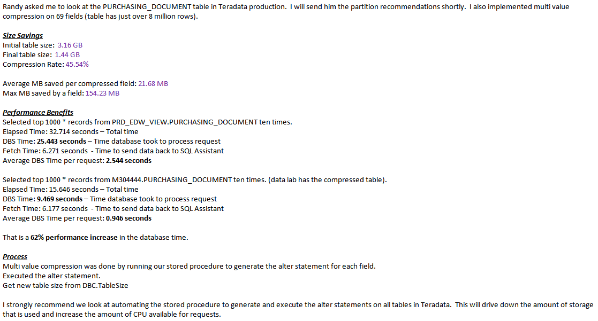

Slide 26
Data Labs
Individual data labs
Ability to test out changes
Import/Export
Organizational data labs
How individual groups can create their own master data for analysis
Upload small amounts of data instead of downloading large amounts of data
TD Load
Example of master data management

Slide 27

Teradata Data Lab
Active Workload Management
Breakdown the barriers with the Teradata Data Lab
Data Lab inside your Teradata EDW
Non-production or experimental data quickly loaded into your Data Lab
Temporary environment
Used for rapid prototyping, experimentation, and exploratory analysis
Self-provisioning, management and service at the business unit level
Enterprise Data Warehouse
Data
Lab
SAS
data
Production
csv
data
External Data
Read, write
Read only for Data Lab users
Use analytic tools to join and explore combined data
Notes:
If the user’s don’t know how to create a primary index, they may not select a unique primary indexl
Read only on Data Lab users.

Slide 28
Benefits of the Data Lab
Benefits from a Business User perspective: | Benefits from IT’s perspective:
Independence Power user self provision to quickly create a data lab environment Self service analytics to leverage your existing BI and Statistical tools Efficiency No hardware or software procurement Join directly to EDW data to eliminate unnecessary data movement. Reduces dependency on IT Speed Employ CPU of EDW for an order of magnitude different in processing time | Simple Centralizes management of Analytic environment within Teradata Simplifies promotion of applications and data Controlled Workload management to minimize impact to production warehouse Security controls maintained Set pre-defined lifecycle and size limitations Cost Reduces consumption of system resources (node, disk I/O, and network) by eliminating unnecessary data movement Eliminates shadow IT and personal external data marts
Notes:
Benefits are numerous for both business users and IT.
From the business Users perspective:
Independence from IT: The Business unit or group can quickly self provision their own Data Lab. They can leverage their favorite in-database tools for exploratory analysis.
Efficiency:
Projects no longer need external data marts that may require hardware and software procurement. Users can self provision a portion of their Teradata data warehouse and quickly analyze data.
Data Lab users can easily join to the EDW production data without data replication or data movement.
Reduces the dependency on IT, waiting for hours or days before data can be loaded.
Speed:
The data lab also leverages the parallel processing of the Teradata data warehouse. Customers have proven that Data Lab processing is orders of magnitudes faster in-database than processing on a server.
From the IT perspective:
Simplifies the environment.
Data marts are reduced and not managed as logical data marts within the Data Lab area. Allows users to centralize their analytics promoting reuse.
This environment also simplifies the migration or productization of data and applications. Although the data and applications will be required to meet DW governance criteria, the data models should be similar and integration is simplified.
Controlled environment:
IT controls the workload management to ensure production warehouses are not impacted.
Since all data and analysis are occurring within a controlled environment, IT can manage and enforce corporate security policies through permissions and access rights.
Expiration dates can be set by IT so that uncleansed data does not linger and become a normal part of business reporting.
Data Lab/Cloud sizes are limited based on IT’s critieria.
Cost:
There are 1000s of small applications running on separate servers and storage systems. These non-mission critical applications all carry a minimum cost of hardware, licenses, and labor. Data labs let you minimize these costs by leveraging the extra cycles in production data warehouse.
The data lab also leverages the unused CPU cycles within the data warehouse, allowing businesses to maximize their system.
Since analysis is taking place against data that is already in the warehouse, data extracts from the warehouse are eliminated; also eliminating the associated resource consumption of node, disk I/O, and network.

Slide 29
SQL Tips and Tricks
Aggregate functions
Analytical functions
Build a real life example that links engine removal events with shop visits
Review DBC structure and some useful queries
Review DBQL structure and how to find old queries

